Slide 1

Experiential Learning Project Assessment-I on
“ Random Password Generator in Python”
under the course
Python Programming Language (N-PCCCM304P)
Presented By
Under the Guidance of
Mrs. Mayuri Getme
Bhumika Dandare
- CM25012
Session:2026-27 (ODD )
Department of CSE(AI&ML)
S. B. JAIN INSTITUTE OF TECHNOLOGY MANAGEMENT AND
RESEARCH,NAGPUR
An Autonomous Institute, Affiliated to RTMNU, Nagpur
)

Slide 2

Content
Problem statement
Objectives
Algorithm
Flowchart/pseudocode
Understanding of Python logic
GitHub account, repository creation, uploading code, meaningful commits, collaboration, individual contribution
S. B. Jain Institute of Technology Management and research

Slide 3

Problem Statement
We use passwords for many online accounts.
Simple and repeated passwords are easier to guess.
Creating a different strong password for every account can be difficult.
Users need passwords with a combination of different characters.
Therefore, we developed a Python program that automatically generates customizable passwords.
The user can decide the length and character types used in the password.
Character Types
Uppercase: A–Z
Lowercase: a–z
Numbers: 0–9
Special Characters: @, #, $, %, etc.

Slide 4

Objectives
To develop a practical application using Python.
To generate passwords automatically using random character selection.
To allow users to customize password length.
To provide different character-selection options.
To understand Python concepts through a real-world problem.
To apply conditions, loops, functions and modules.
To learn secure random generation using the secrets module.
To gain practical experience with GitHub and version control.

Slide 5

Algorithm
Step 1: Start the program.
Step 2: Ask the user to enter the required password length.
Step 3: Ask the user whether to include: Uppercase letters Lowercase letters Numbers Special symbols
Step 4: Create an empty character set.
Step 5: Add the selected character types to the character set.
Step 6: Check whether the character set is empty. If Yes, display "Please select at least one character type" and stop. If No, continue.
Step 7: Randomly select characters from the character set until the required password length is reached.
Step 8: Display the generated password.
Step 9: End the program.

Slide 6

Flowchart
start
Enter Password Length
Select Character Types
Uppercase
Lowercase
Numbers
Symbol

Slide 7
A
Create Character Set from selected types
Is the character set empty
Display Error:
Please select at least one charecter
Generate random
Character until required length

Slide 8
B
End
Display the generate password
End

Slide 9

Understanding Of Python Logic
.Variables: Used to store information such as password length and the generated password.
Input: The input() function is used to take the required password length and choices from the user.
If Condition: Used to check which types of characters the user wants to include.
Loop: Used to repeatedly select characters until the required password length is reached.
Function: Helps organize the password-generation process into a reusable block of code.
String: Used to handle letters, numbers, and special characters.
Modules: The string and secrets modules provide useful features for password generation.
Random Selection: secrets.choice() selects a character randomly from the available character set.

Slide 10

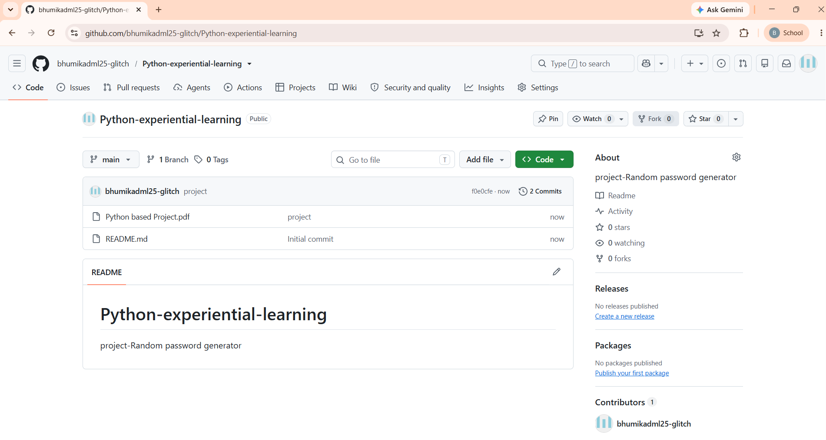
Git GitHub account, repository creation, uploading code, meaningful commits, collaboration, individual contribution
A repository is an online storage space where the project’s Python code, files, documentation, and version history are maintained. A commit records project changes with a clear message, such as “Added password generation logic”, making the project history easy to understand.

Slide 11
Thank You
S. B. Jain Institute of Technology Management and research

